Slide 1
TIR at MU: Inspiring Future Teachers through Physics First
Kory Kaufman and Karen King
University of Missouri-Columbia
7/27/2015

Slide 2
Getting to know each other
Is there a shortage of physics teachers in your school/community?
What have you done to recruit new highly qualified physics teachers?
What opportunities do your future physics teachers have to prepare for teaching?
Has it been successful?

Slide 3
TIR Inspiring Future Teachers
Missouri’s needs & MU’s numbers
Selling Teaching
Physics First Uniform Motion labs
What Learning Assistants do
The role of Teacher in Residence
Fostering partnerships
Preparing LAs
Handling Logistics
Challenges
Sustainability in the Future
Notes:
Old slide outline from Doug and Karen’s earlier presentation. Can use similar outline maybe. I added future.

Slide 4
Physics Enrollment in Missouri
Data: Mo-DESE; Graph: Prepared by ARC
MSP09
MSP06
Notes:
Meera’s notes: In a nutshell, the number of students taking a high school physics course has doubled since our project started.
How do we compare nationally?

Slide 5
Annual # of new physics teachers (“College Recommended”)
MU projection
for 2015-17.
2007-2012
2012-2014
2015-2017
Statewide, only 5.6/year from BS programs.
MU only 0.2/year
MU PhysTEC reforms.
MU up to 1/yr
MU anticipates
3.5/yr
(currently 10 majors)
Notes:
Not sure about this slide.

Slide 6
Annual # of BS degrees in physics education
Notes:
C:\Users\kingkar\Dropbox\PhysTEC\PhysTEC shared docs\Student Tracking and Recruiting lists

Slide 7
TIR Inspiring Future Teachers
Missouri’s needs & MU’s numbers
Selling Teaching
Physics First
What Learning Assistants do
The role of Teacher in Residence
Fostering Partnerships
Preparing LAs
Handling Logistics
Challenges
Sustainability in the Future
Notes:
Old slide outline from Doug and Karen’s earlier presentation. Can use similar outline maybe. I added future.

Slide 8
How did we sell teaching?
Connecting to students [Johnson, 2005]
Serving society [Guarino, 2006]
Physics First curriculum
Notes:
S.M. Johnson, J.H.Berg, and M.L. Donaldson, “Who stays in teaching and why: A review of the literature on teacher retention,” The Project on the Next Generation of Teachers, (Harvard Graduate School of Education, Cambridge, MA, 2005).
[16] C.M. Guarino, L. Santibañez, and G.A. Daley, “Teacher Recruitment and Retention: A Review of the Recent Empirical Literature,” Review of Educational Research, 76 (2006).

Slide 9
Why Physics First?
Physics First was implemented in several Missouri schools in 2006.
Physics First was a success with high school freshman and it also inspired the University physics students.
The modeling approach was unfamiliar to the physics majors. This allowed them to learn how to teach in a different way while reinforcing their own content knowledge.

Slide 10
TIR Inspiring Future Teachers
Missouri’s needs & MU’s numbers
Selling Teaching
Physics First Uniform Motion labs
What Learning Assistants do
The role of Teacher in Residence
Fostering partnerships
Preparing LAs
Handling Logistics
Challenges
Sustainability in the Future
Notes:
Old slide outline from Doug and Karen’s earlier presentation. Can use similar outline maybe. I added future.

Slide 11
Learning Assistants (LA) in high schools
Facilitate collaborative learning
Using tools of the trade (equipment & materials specific to physics)
Learn from master teachers.
Interaction with high school students.
Learn to use effective teaching strategies.
What does an LA do?
~4 hrs / wk with
same class

Slide 12
A Physics First Lesson
Motion Activity

Slide 13
Inspiring Future Teachers
What would an undergraduate student gain from helping lead the bubble tube lab?
Satisfaction of helping students
Motivation: Both students and themselves
Learning how to teach using modeling method

Slide 14
Reflection
What things would you do to prepare the LA’s to be effective to help students learn the objectives in this specific lesson? (What do you think the objectives were?)

Slide 15
“The most rewarding experience was generally getting to know the kids. That's what makes teaching what it is.”
-Learning Assistant Spring 2014 (assigned to a 9th grade classroom)

Slide 16
TIR Inspiring Future Teachers
Missouri’s needs & MU’s numbers
Selling Teaching
Physics First Uniform Motion labs
What Learning Assistants do
The role of Teacher in Residence
Fostering partnerships
Recruiting LAs
Preparing LAs
Handling Logistics
Challenges
Sustainability in the Future
Notes:
Old slide outline from Doug and Karen’s earlier presentation. Can use similar outline maybe. I added future.

Slide 17
Fostering Partnerships
Necessary collaboration between the Physics Department, College of Education, and Columbia Public Schools. The role of the Teacher in Residence is to coordinate it all.
Co

Slide 18
Physics Education Majors
Courses
15-20 hours / semester for 3 semesters
LA
Physics specific
More interaction with students
Science education methods I-III
Field
~60 hours per semester
Sometimes in physics classrooms (sometimes not)

Slide 19
A partnership in teacher development
Field placements & networking for future teachers
“Physics First” program
TOP Teachers
A TIME for Physics First
In-service professional development program
NSF MSP support
Cooperating Teachers
Tomorrow’s Outstanding Physics Teachers
Educating pre-service
PhysTEC support
Learning Assistants (LA)
New teachers trained in Physics First curriculum
Notes:
Academy for Teachers using Inquiry and Modeling Experiences

Slide 20
Recruiting
Physics building HDTV
Flyers
Bulletin Boards

Slide 21
Preparing LAs
Physics pedagogy course
Weekly Meetings
Observing LA’s in their classrooms
Observing science methods course presentations
Mentoring
Writing Letters of Recommendation

Slide 22
Weekly meeting with TIR
Teaching Prep:
Physics Content
Modeling Physics Pedagogy
Questioning Strategies
Student Interaction Strategies
Issues in the Classroom (Individual)
Logistics
Classroom Procedures and Expectations
Safety Issues
Responsibilities

Slide 23
TIR as Logistics Guru
Field placement
COE placement officer
Selecting cooperating teachers
Coordinating teacher & LA schedules
Paperwork
Background checks
Hiring process
Photo releases, etc
Payroll
Balancing field credit vs paid LA hours
(no double dipping!)

Slide 24
Results

Slide 25
Only 1 of the 19 respondents had a decreased interest
Notes:
BUG Karen for new data

Slide 26
Did your interest in becoming a high school teacher increase, decrease, or remain the same?
Notes:
(This is also from just first 2 years)

Slide 27
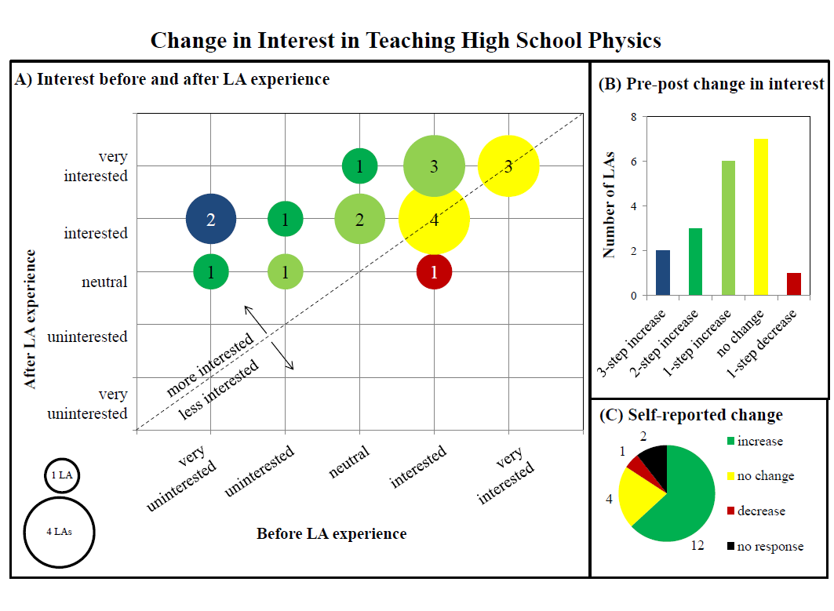

Slide 28
TIR Inspiring Future Teachers
Missouri’s needs & MU’s numbers
Selling Teaching
Physics First Uniform Motion labs
What Learning Assistants do
The role of Teacher in Residence
Fostering partnerships
Recruiting LAs
Preparing LAs
Handling Logistics
Challenges
Sustainability in the Future
Notes:
Old slide outline from Doug and Karen’s earlier presentation. Can use similar outline maybe. I added future.

Slide 29
Challenges
Physics First teacher turnover
Recruiting & completing the hire
Scheduling
Funding
College of Education decided to no longer offer the post-baccalaureate program.

Slide 30
TIR Inspiring Future Teachers
Missouri’s needs & MU’s numbers
Selling Teaching
Physics First Uniform Motion labs
What Learning Assistants do
The role of Teacher in Residence
Fostering partnerships
Recruiting LAs
Preparing LAs
Handling Logistics
Challenges
Sustainability in the Future
Notes:
Old slide outline from Doug and Karen’s earlier presentation. Can use similar outline maybe. I added future.

Slide 31
Sustainability
MU has committed to sustaining our key program elements for at least the next 3 years:
Teacher in Residence
Learning Assistant program
Physics Pedagogy course
Graduate research assistants
MU is building partnerships with institutions that offer post-baccalaureate options.
Notes:
We have internal funding from six sources: 1) Dean’s office of College of Arts and Sciences; 2) Dept. of Physics and Astronomy; 3) Dean’s office from College of Education; 4) Dept. of Learning, Teaching & Curriculum; 5) MU Research Incentive Fund; 6) CASH program, which cost-matches salaries for UG

Slide 32
What the Learning Assistants say…
The best part of being an LA was connecting with students. This happened almost daily. Inspiring students was one of the best feelings in the world.
– physics major
It helped me learn how to be a teacher much more than any field study course, or course in general for that matter, [I] have ever taken in the college of education.
–physics education major
Notes:
Add more recent statements

Slide 33
More Testimonials
“I have always wanted to be a high school physics teacher, but this program reassured me that I was going into the right field. Having the opportunity to work with the students and experienced teachers, put me in real life situations that I can see myself in in the future.”
“I've never really thought about going into education for a career, but this program has definitely piqued my interest. My interest level to pursue a career as a high school teacher has only increased slightly, though I am now very interested in pursuing a career in physics education on a higher level.”
“I think the reason I liked teaching in the first place was reaffirmed. In short, you just got to know the kids. The students in both of my experiences were very different, but, in both, getting to know them was the special part of the experience.”

Slide 34
MU’s TOP Teachers: Tomorrow’s Outstanding Physics Teachers Karen King (kingkar@missouri.edu) Kory Kaufman (kkaufman@cpsk12.org)
http://topteacher.missouri.edu
facebook.com/MUTOPteacher

Slide 35
Acknowledgements
Funding for this project was provided by PhysTEC through a subward from the American Physical Society’s NSF Grant No. 0808790, CFDA No. 47.0490

